Slide 1
LEAD SCORE CASE STUDY
LOGISTIC REGRESSION

Slide 2
PROBLEM STATEMENT
X Education is an Organisation which provides online courses for industry professionals.The company marks its courses on several popular websites .
X Education wants to select most promising leads that can be converted to paying customers.
Although the company generates a lot of leads only a few are converted into paying customers ,where in the company wants a higher lead conversion,Leads come through numerous modes like email,advertisements on websites ,searches etc.

Slide 3
BUSINESS GOAL
The company requires a model to be built for selecting more promising Leads.
Lead Score to be given to each leads such that it indicates how promising the lead could be.The higher the Lead score the more promising the lead to get converted, the lower it is the lesser the chances of conversion.
The model to be built in lead conversion rate around 80% or more.

Slide 4
STRATEGY
Import Data
Clean and prepare the data for analysis
EDA for figuring out the helpful attributes
Scaling Features
Prepare data for model Building
Build a Logistic regression Model
Test the model on trainset
Evaluate the Model based on different measures
Test the model on test set
Measure the accuary and other metrics for evaluation

Slide 5
Data Sourcing,Cleaning & Preparation
Read the data from CSV file
Handling Null values and removing Higher null values data
Excluding Redundant columns in Data
Imputing Null values
Removing all the single valued Data for proper analysis

Slide 6
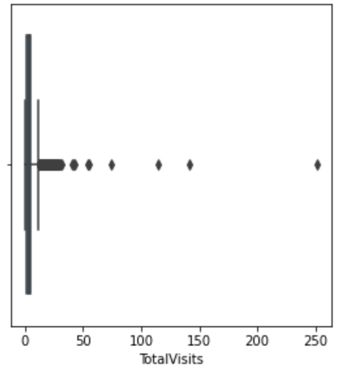
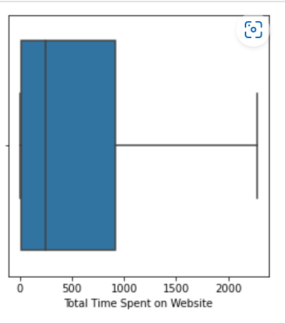
Exploratory Data Analysis
There are outliers present in few columns which would reduce the accuracy of the model.remove the outliers for futher analysis.

Slide 7
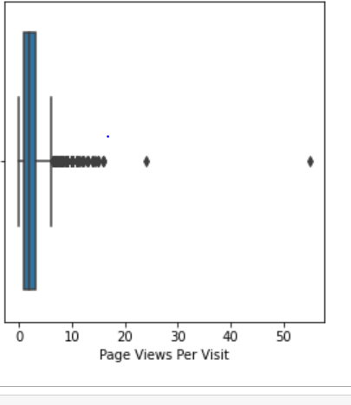
Removing outliers
From the above 3 Numerical variables
The variables ‘The Total Visits’ and “Page Views Per Visit “ have outliers .
Remove the outliers by capping them to 0.99 percentile

Slide 8
MODEL BUILDING
Splitting into train and test set
Scale variables in train test
Build the first model
Use RFE to eliminate less relevant variables
Build the next model
Eliminate variables based on high P values
Check VIF value for all the exisiting Columns
Predict using test set
Evaluate accuracy and other metrics
Predict using test test
Analysis on test predicitons

Slide 9
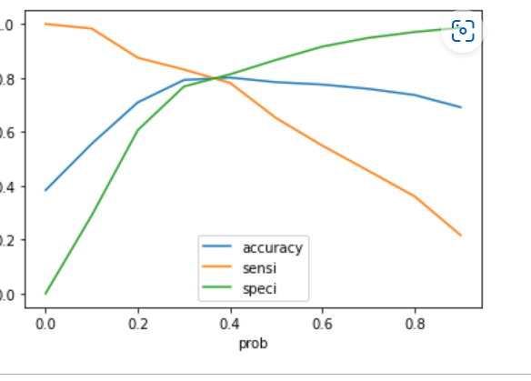
MODEL EVALUATION:Sensitivity & Specificity on Train Data Set
Graph depicts an optimal cutoff of 0.35
Based on Accuracy ,Sensitivity and Specificity
Accuracy:0.80
Sensitivity:0.65
Specificity:0.86

Slide 10
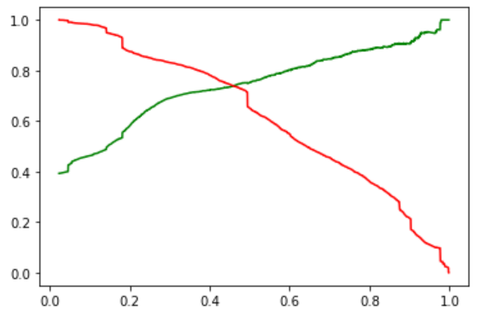
Model Evaluation
The graph Predicts Optimal cutoff of
0.42 on Precision and Recall
Precision:0.70
Recall:0.77

Slide 11
Model Evaluation On Test Set
Accuracy:0.80
Sensitivity:0.82
Specificity:0.79

Slide 12
CONCLUSION
The variables that mattered the most in the potential buyers are
The total time spend on the Website.
When the lead source was: Welingak website
When the last activity was:
a. Phone Conversation
b. Olark chat conversation
When the Lead Origin is Lead Add Form
With all these Observations X Education will be easily able to identify potential leads and convert them into a successful buyer.

Slide 13
THANK YOU

